Slide 1
CDC Breastfeeding support initiative Technical Presentation
We Didn’t Start The FHIR
Presented by: Justin Kristensen & John Van Wagenen

Slide 2
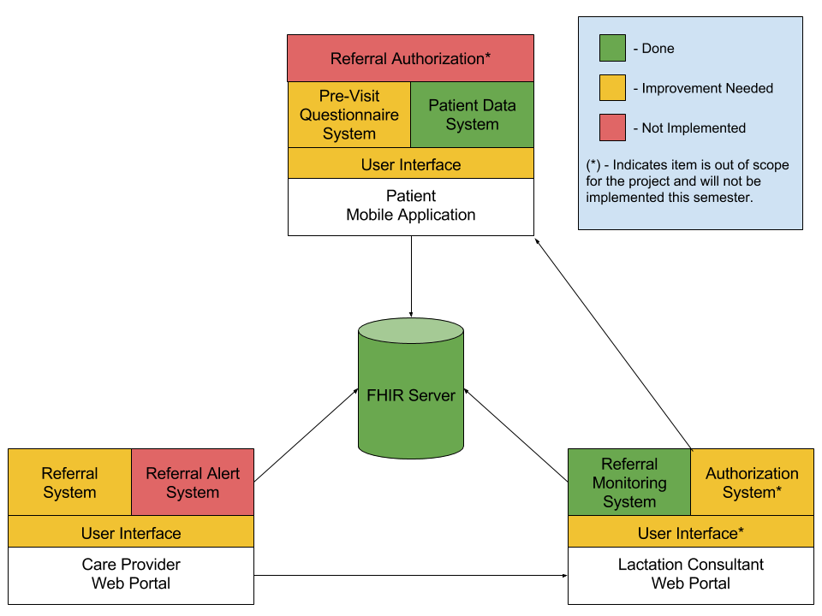
Architecture Diagram

Slide 3
Architecture Diagram (Applications)
The system is composed of three main applications:
•Patient Mobile Application:
•Sends patient’s Breastfeeding data
•Sends patient’s answers to questionnaire
•Care Provider Web Portal:
•Access patient’s Breastfeeding data
•Send referral data to Lactation Consultants
•Lactation Consultant Web Portal:
•Can accept or reject patient referrals
•Send referral information to the patient

Slide 4
Architecture Diagram (Components)
Each application is composed of several components:
Patient Mobile Application
Referral Authorization*
Pre-visit Questionnaire System
Patient Data system*
User Interface
Care Provider Web Portal
Referral System
Referral Alert System
User Interface
Lactation Consultant Web Portal
Referral Monitoring System*
Authorization System*
User Interface*
(*) - Indicates that the component has been implemented or will not be implemented this semester's project.

Slide 5
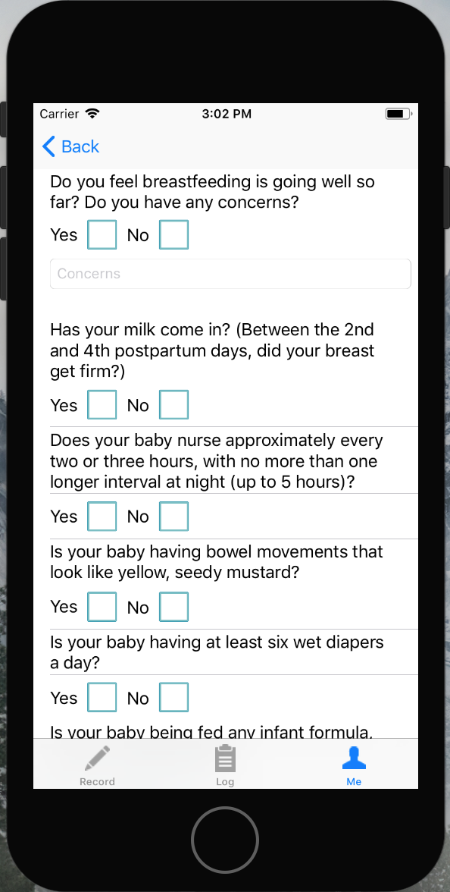
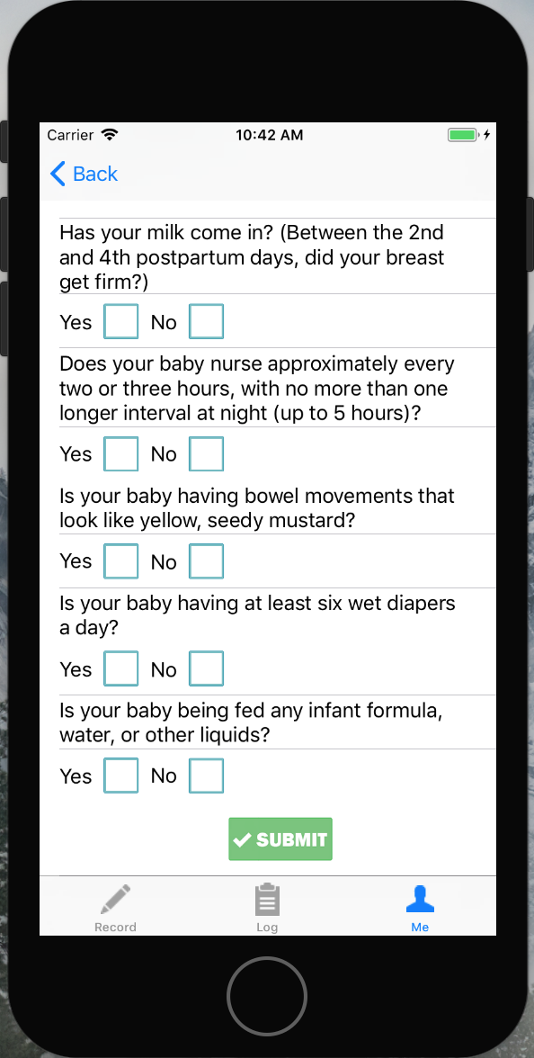
Screen Prototypes (patient mobile application Questionnaire)

Slide 6
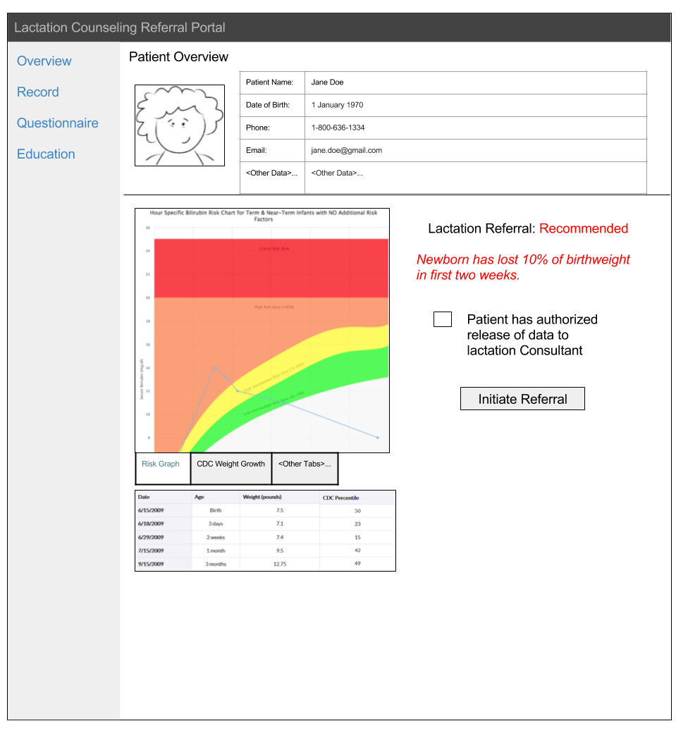
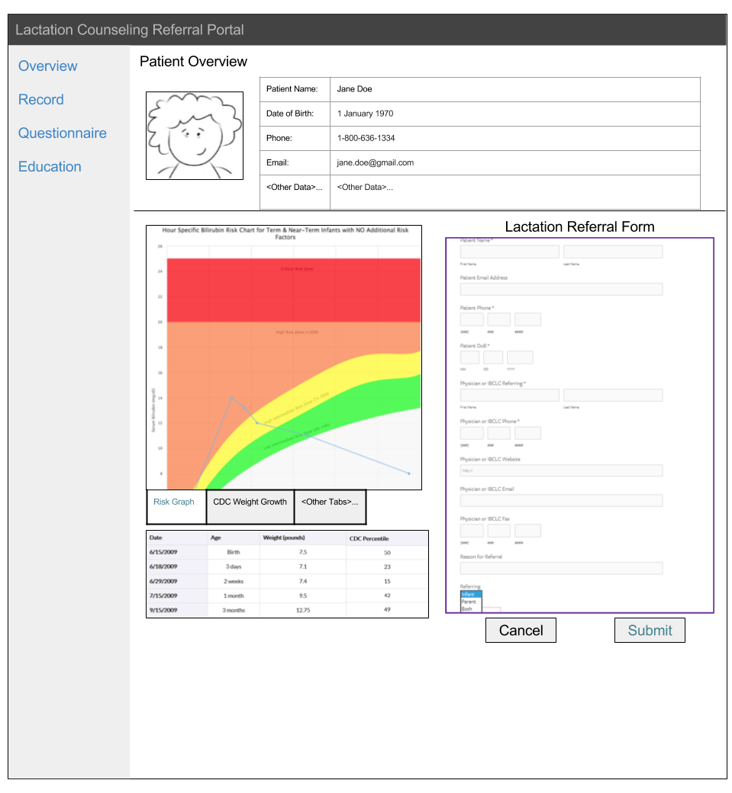
Screen Prototypes (Care Provider Web Portal)
Initiate Referral
Clicked

Slide 7
Tools/Languages
Based on the current provided by the previous group, we'll use:
For the Web Portals:
JQuery (Frontend)
Bootstrap (Frontend)
RESTful API
SMART on FHIR
For the Patient Application:
IOS (Swift)
Xcode

Slide 8
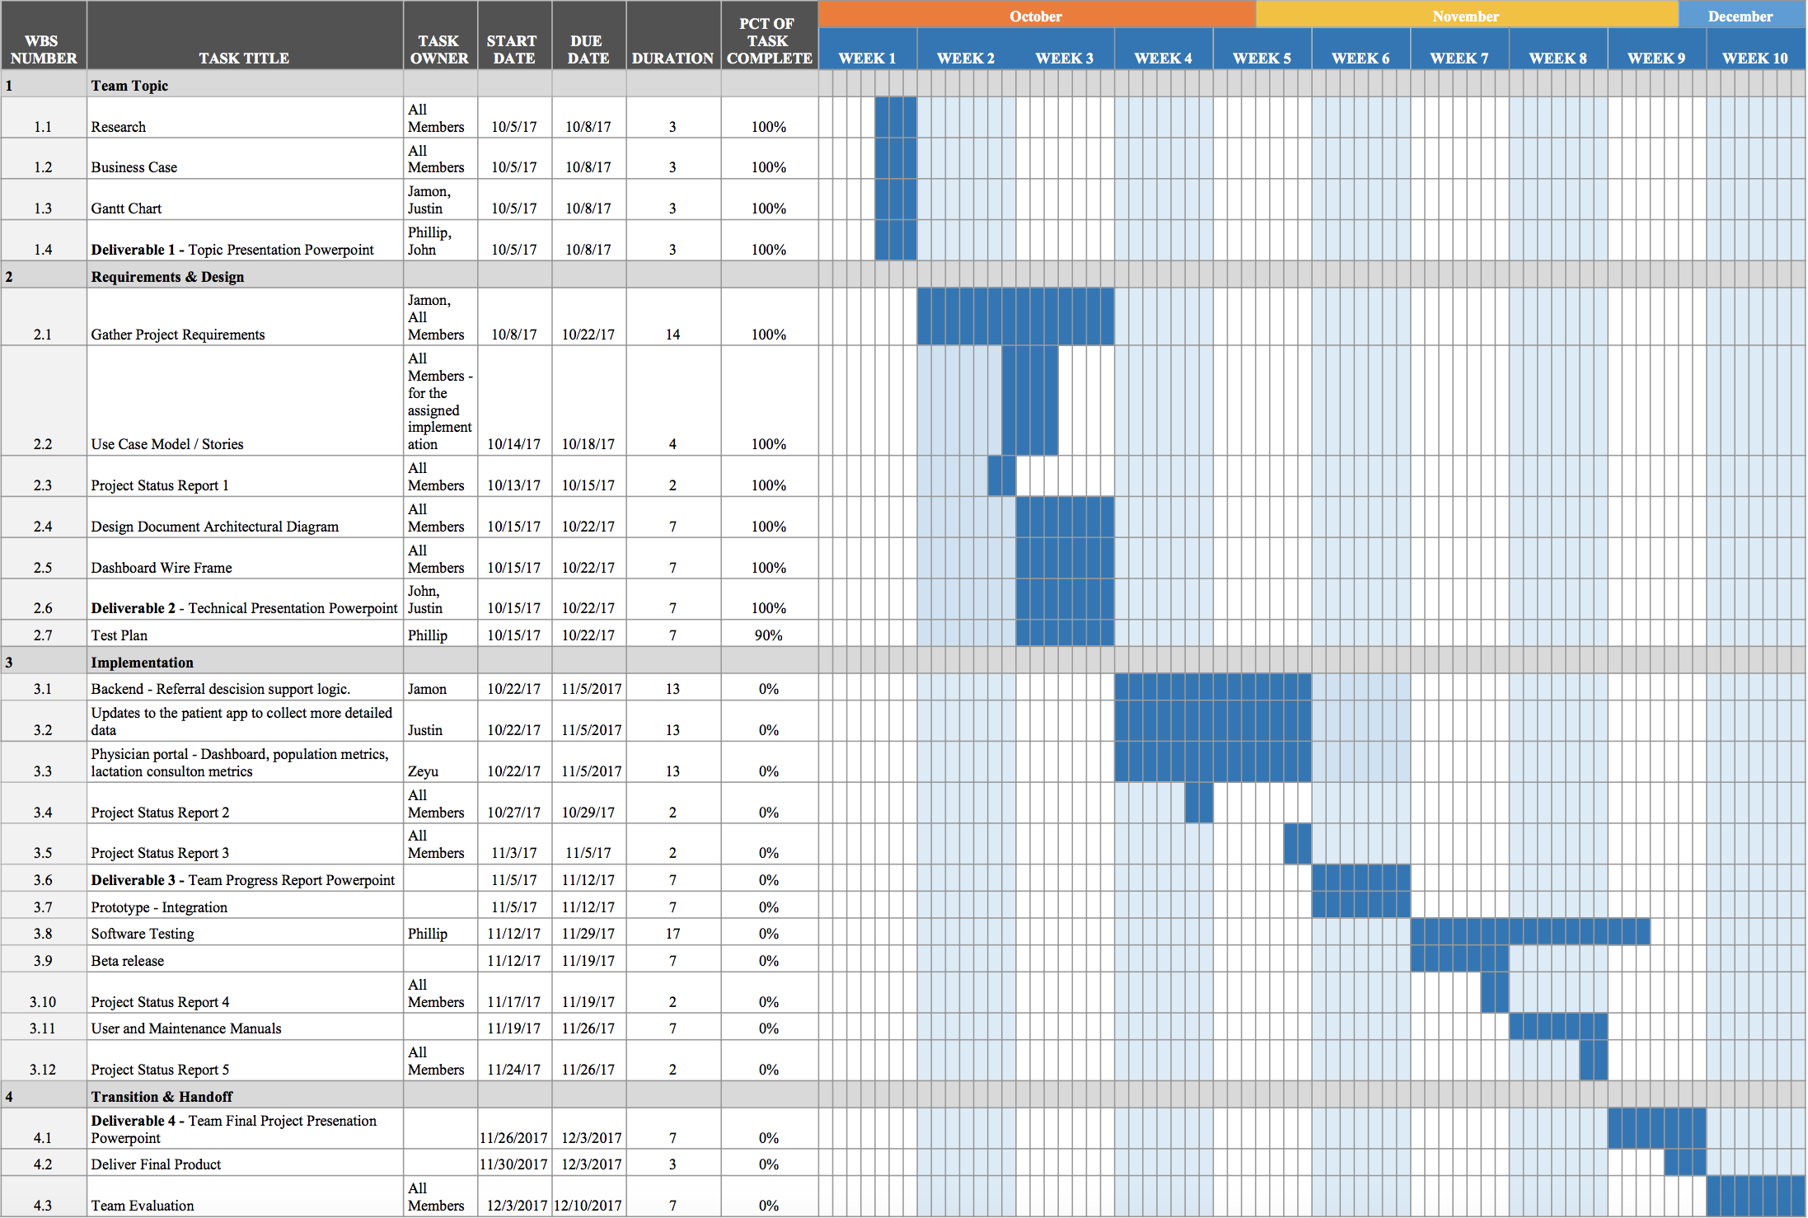
Gantt Chart Update

